Slide 1
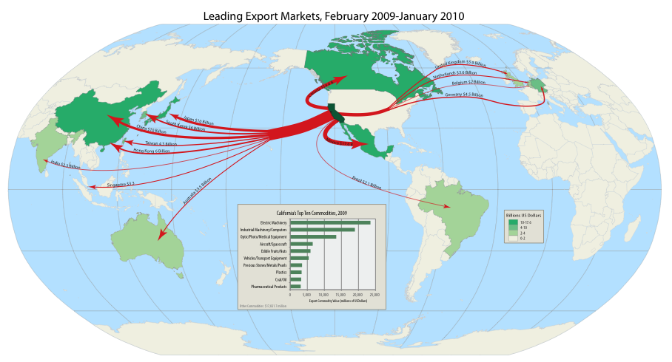
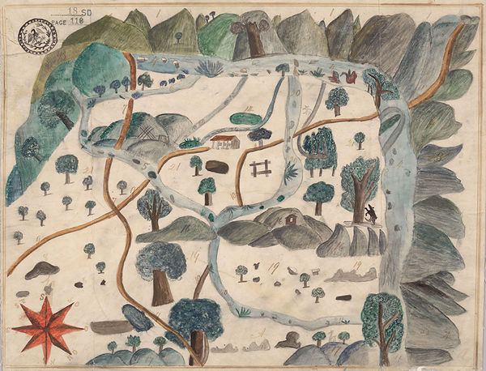
UC Bancroft Library
California:
Much more than missions and a Gold Rush

Slide 2
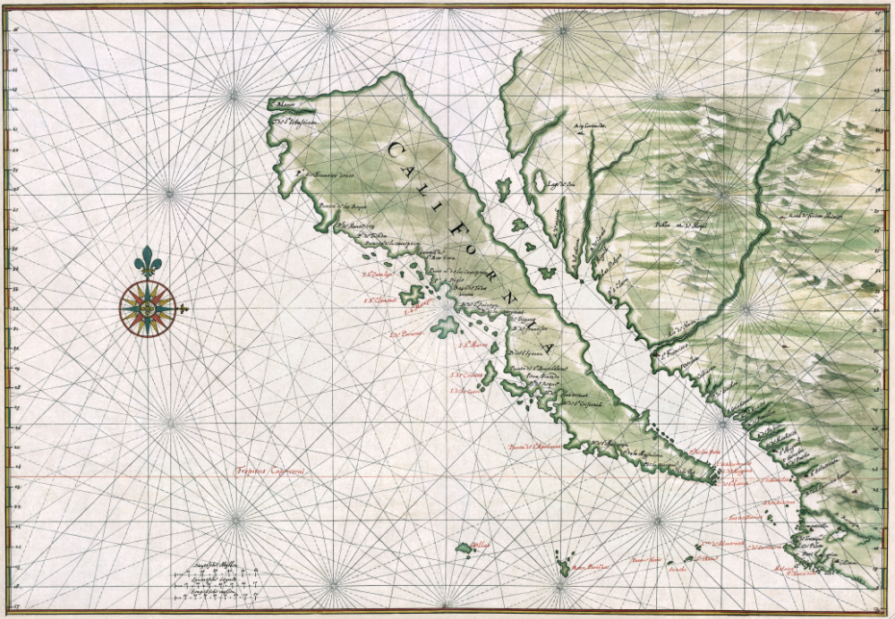
Know that to the right hand of the Indies exists an island called California, very near the Terrestrial Paradise... And there ruled over that island a queen of majestic proportions, who accomplished great deeds. She was valiant and courageous and ardent with a brave heart—Queen Califa. García Ordóñez de Montalvo (1510)
Naming California
California as an Island: circa 1650, Johannes Vingboons

Slide 3
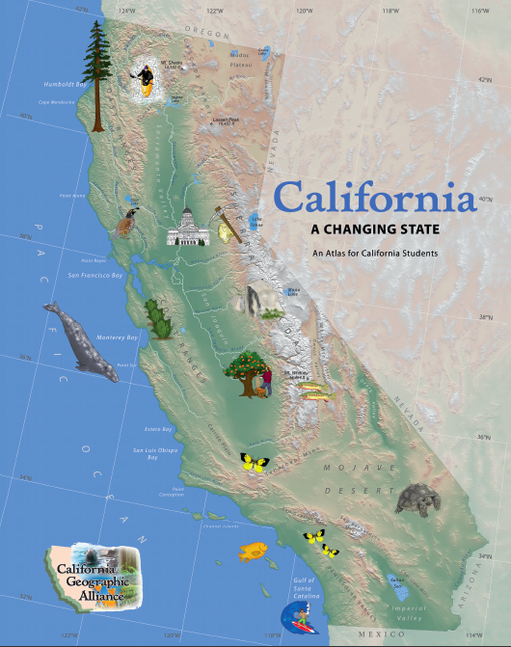
Introduction
This program uses the Atlas of California to investigate the geographic factors that make Queen Califa’s “terrestrial paradise” unique.

Slide 4
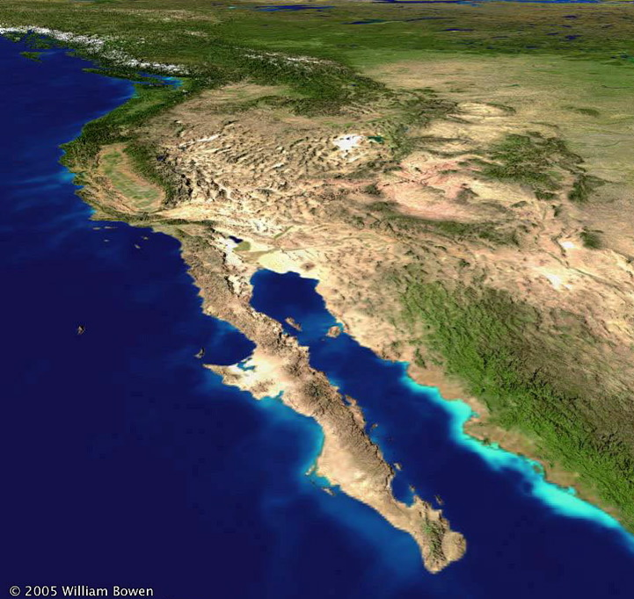
What makes the land of Queen Califa unique?

Slide 5
What makes the land of Queen Califa unique?
Location
Size
Topography
Climate
Population
Economy

Slide 6
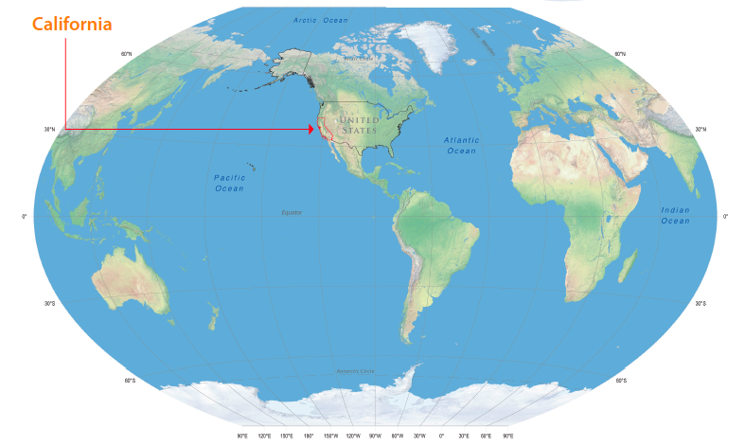
Unique California: Location
temperate mid-latitude (32° - 42° North)
even daylight: 10 – 14 hours
Pacific Rim influences climate, settlement, trade
Tom Patterson, Natural Earth II; Evnir Sys Res Inst

Slide 7
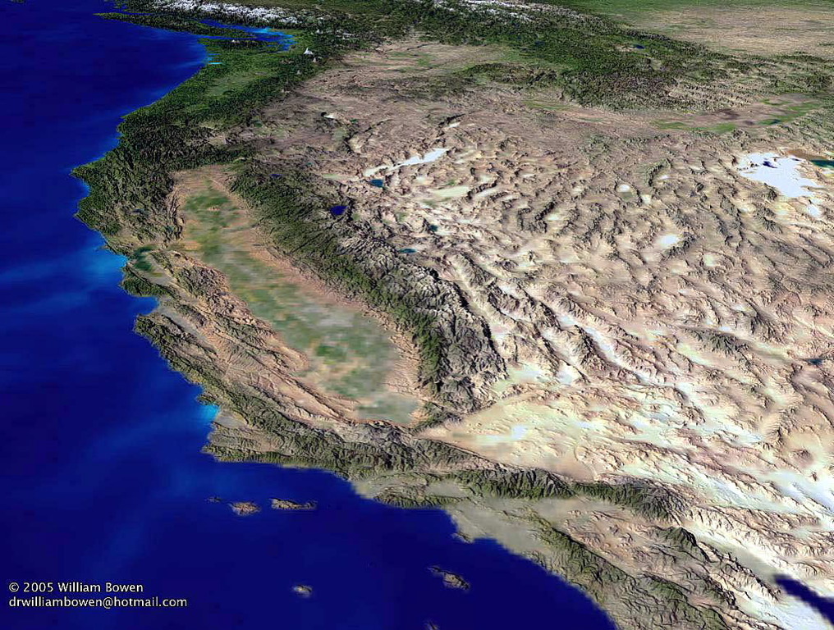
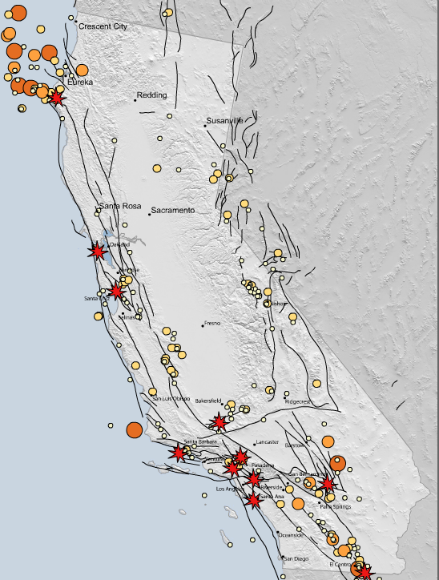
But fault zones riddle western North America.
CA Geol Survey; UC Seismological Lab; NorCal Earthquak Catalog; USGS
Earthquakes
and Fault Zones

Slide 8
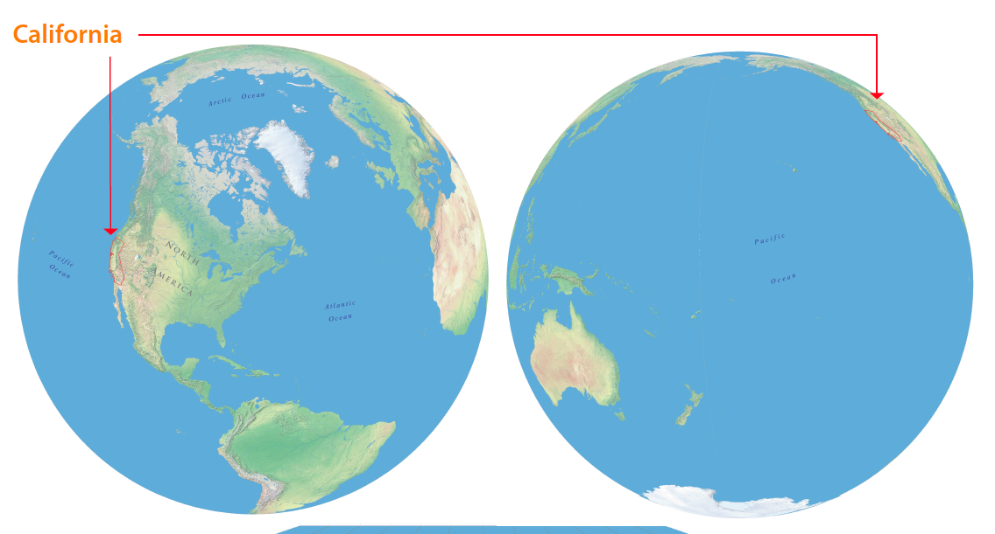
The first Californians crossed the Bering Straits from Asia, then traveled south along the Pacific Rim. Others may also have crossed the Pacific Ocean. The Spaniards were the first Europeans to reach California when Juan Rodriguez Cabrillo arrived in San Diego by ship in 1542. In 1769, they established San Diego de Alcala, the first non-native settlement. American fur trappers entered California overland from the east during 1820s, at the height of the Mission Period.
Tom Patterson, Natural Earth II; Evnir Sys Res Inst

Slide 9
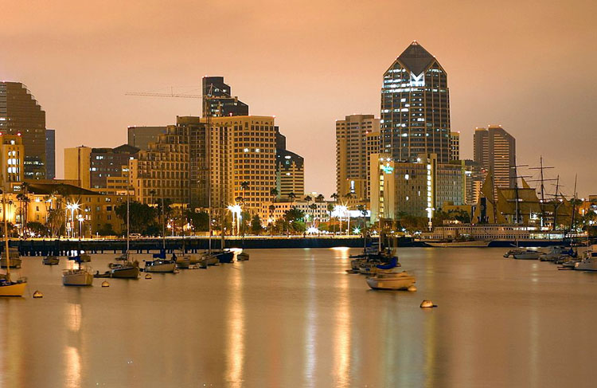
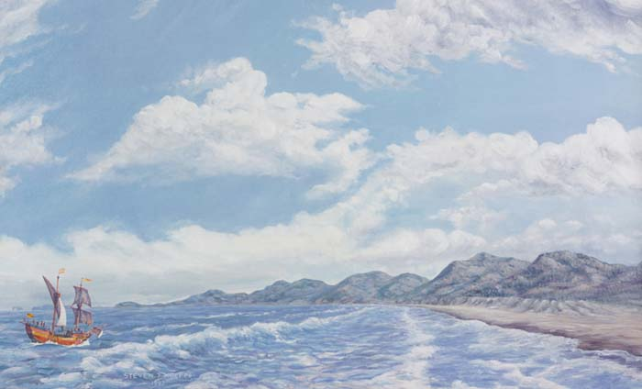
Cabrillo Arrives ~ 1542
WAN Conservancy

Slide 10
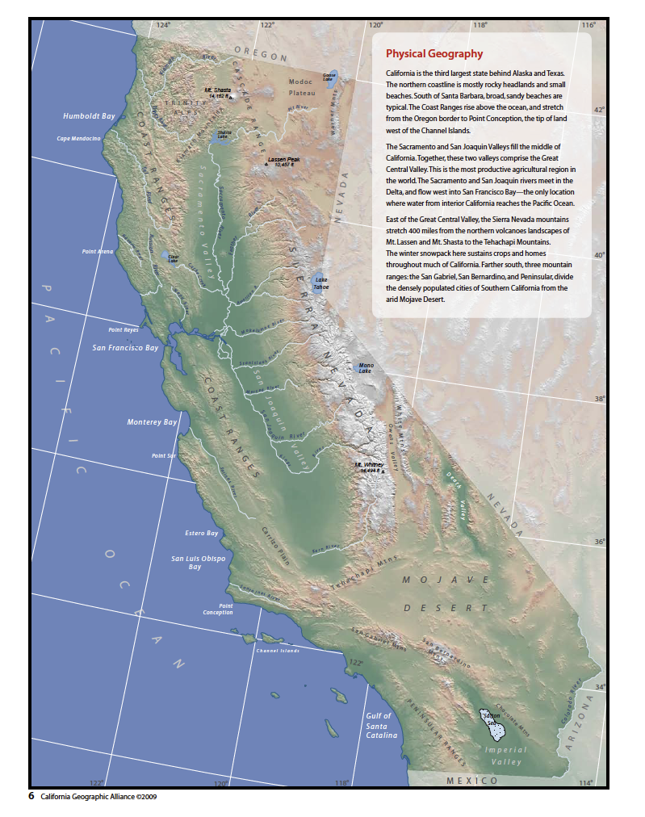
Unique California: Size
100 million acres: 3rd after AK and TX
800 miles long
250 miles wide
CA Spatial Information Library; USGS Digital Elevation Model

Slide 11
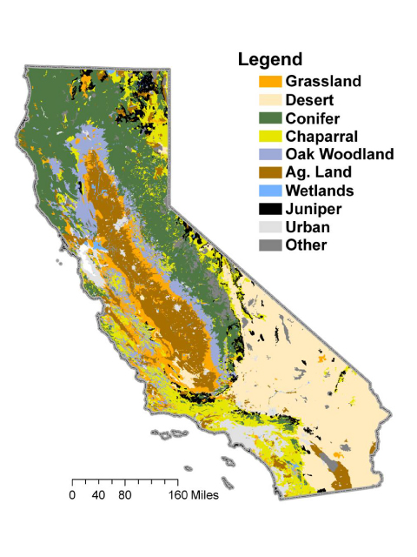
These 100 million acres provide tremendous diversity of …
Land Cover
Topography
Climate
Plants
Animals
Opportunities for human settlement
North to South
East to West
In Rainshadows
UC Davis
More than any other area of comparable size in North America

Slide 12
Unique California: Topography
divided into mountains & valleys
exceeds 14,000 ft. ~ drops 200 ft. below sea level
coastline of rocky headlands and broad beaches

Slide 13
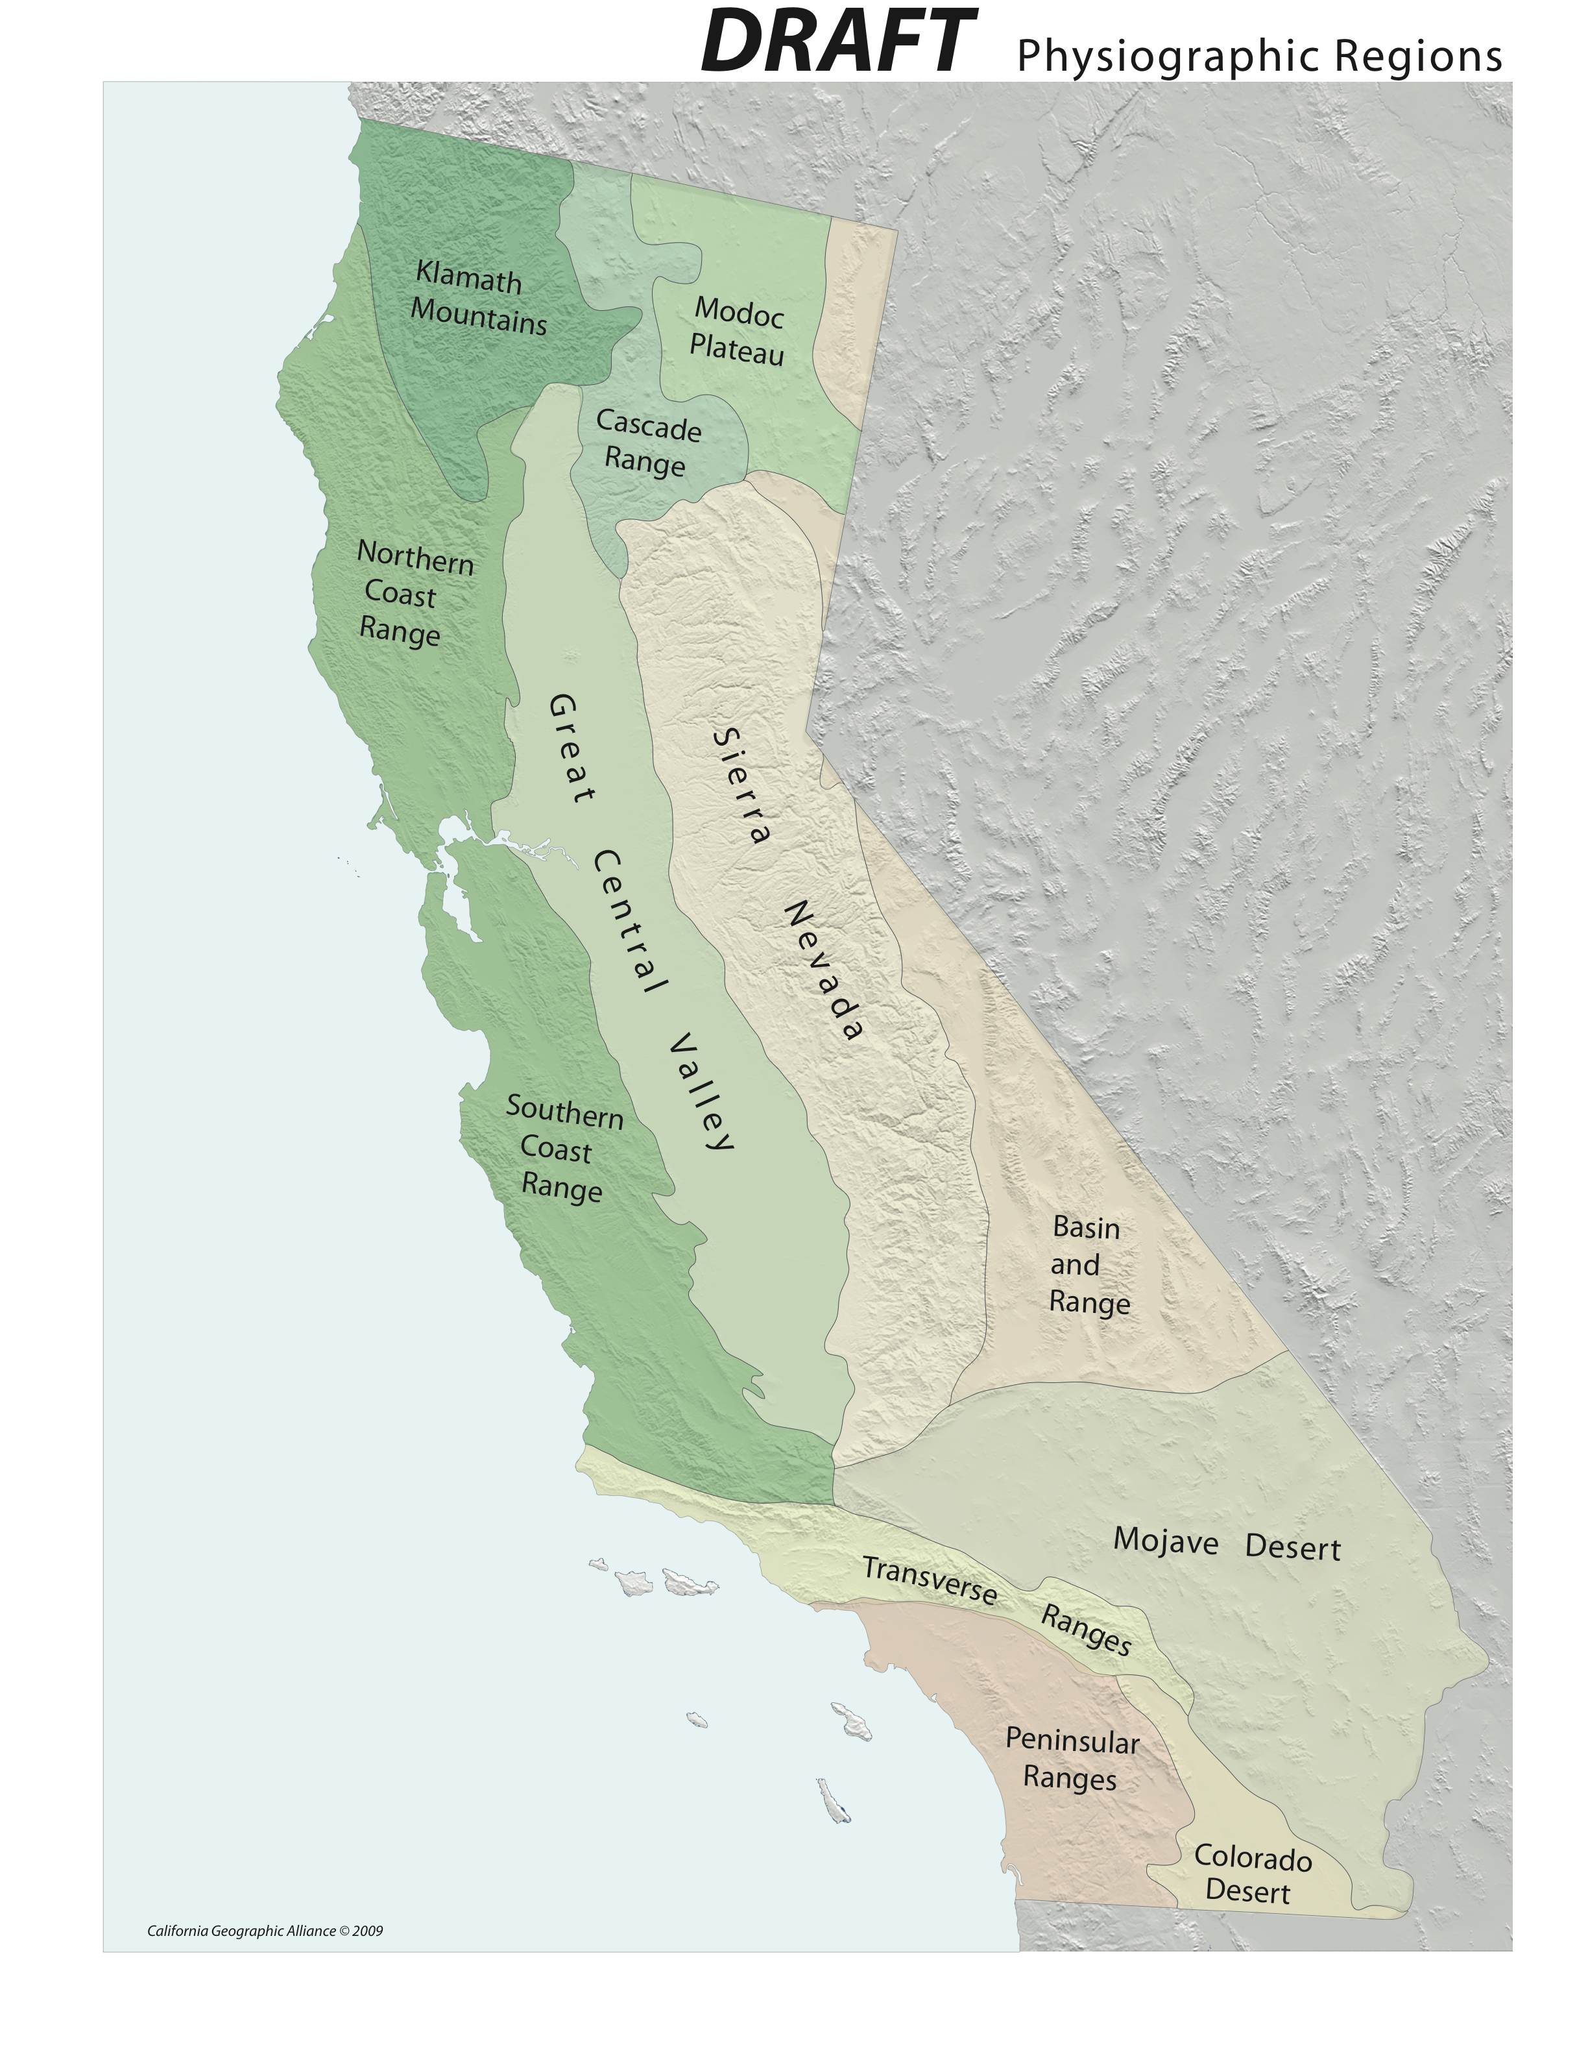
There are 12 Physiographic Regions
Physiography
the shape of the land surface
Low physiographic diversity
FL, OK, IA
High physiographic diversity
AK, CA, VA
Atlas of California (1979)

Slide 14
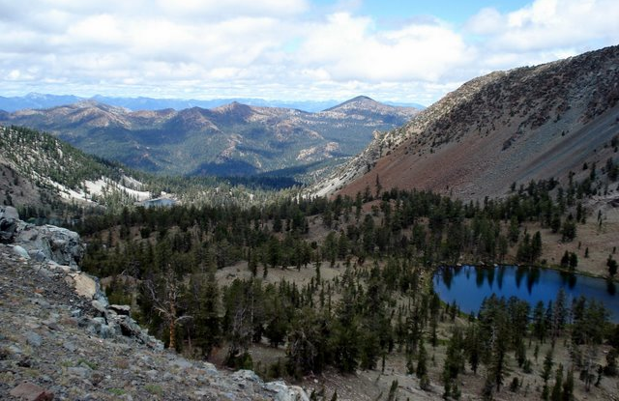
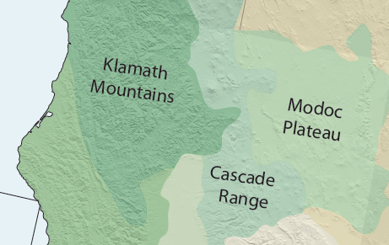
The Klamath Mountains dominate sparsely populated northwestern California.

Slide 15
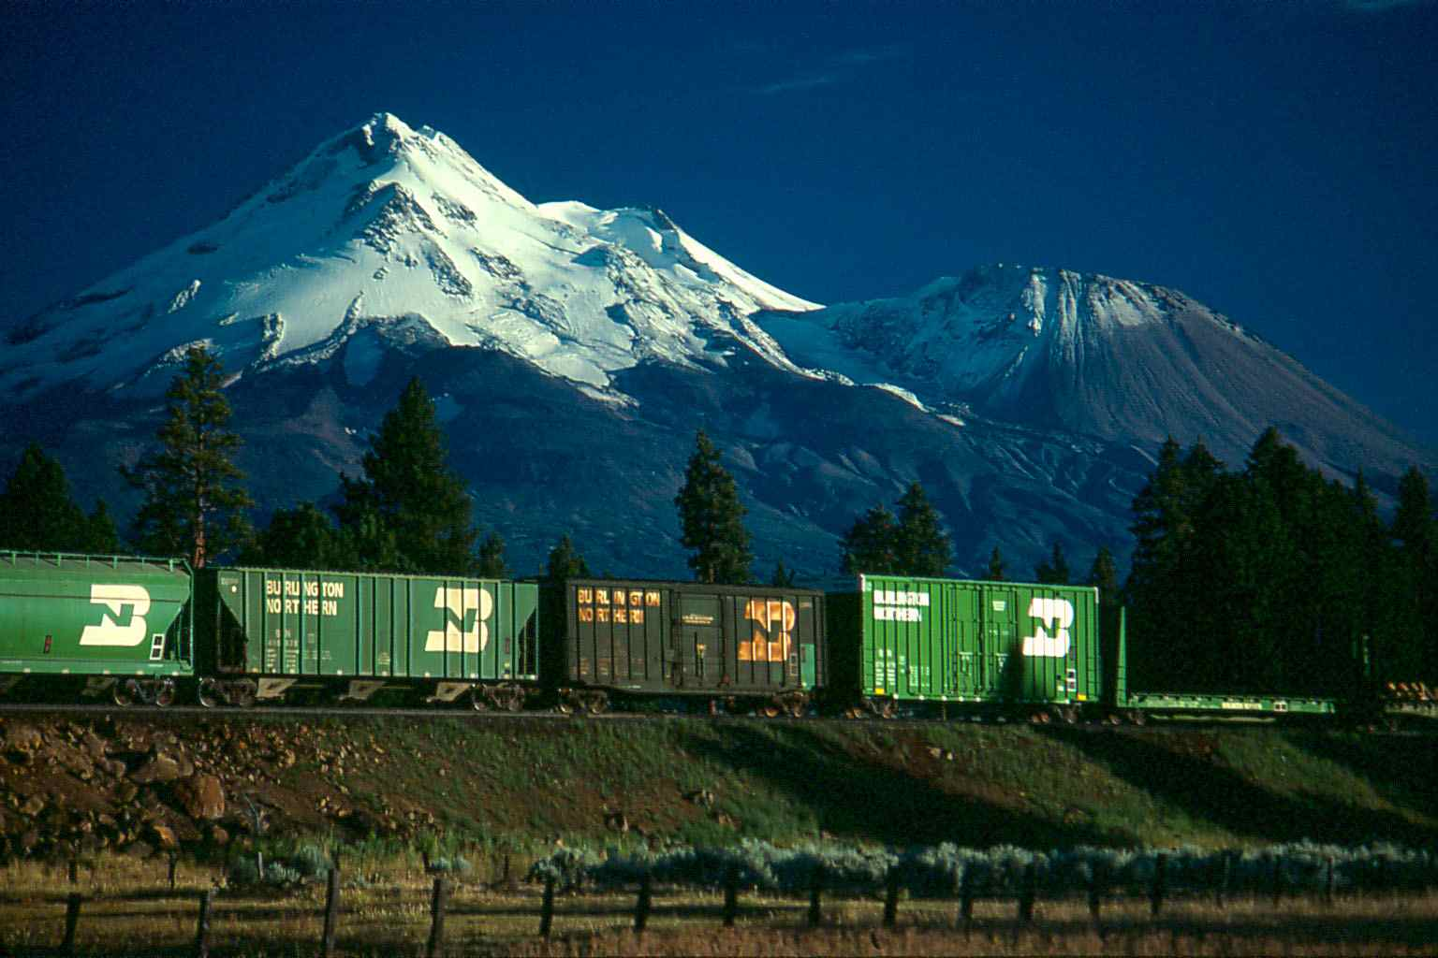
Mt. Shasta (14,162’) and Mt. Lassen (not shown) are the southern terminus of the Cascade Range that stretches north to Oregon and Washington, and includes Mts. Hood, St. Helens, and Rainier.

Slide 16
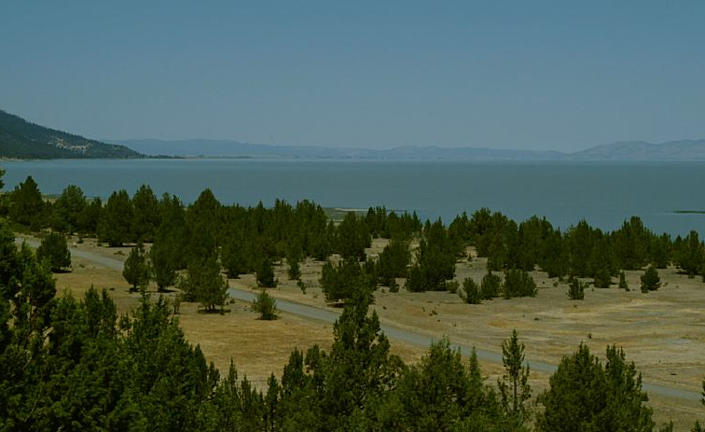
Goose Lake on the Modoc Plateau is one of many saline lakes in eastern California with no outlet to the sea. Evaporating water leaves salt and other minerals behind.

Slide 17
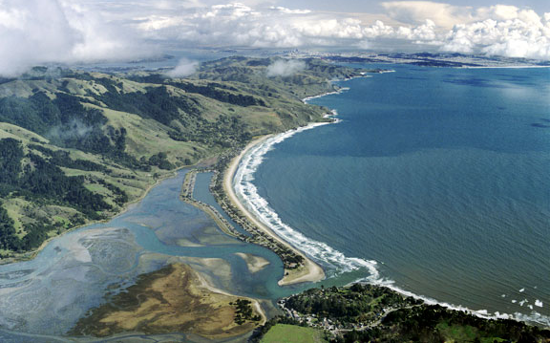
Rocky headlands and coarse sand beaches typify California’s north coast. Stinson Beach is one of many barrier beaches that block the mouth of Coast Range streams in summer. In winter, rain-filled lagoons combined with pounding surf reopen the channels.
Chamoismoon.com

Slide 18
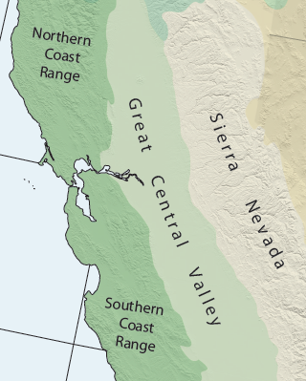
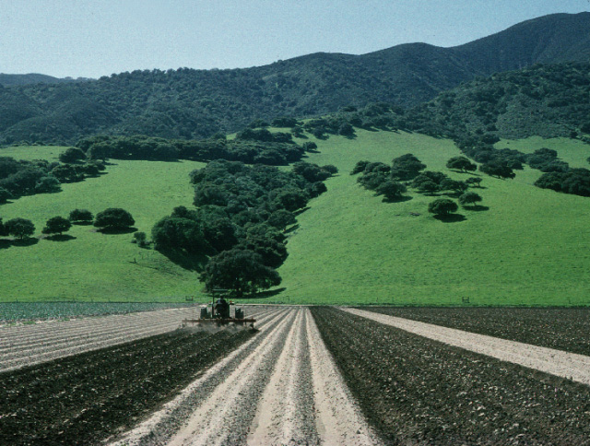
Mountains cloaked in oak and chaparral rise above fertile valleys of the Northern and Southern Coast Range.

Slide 19
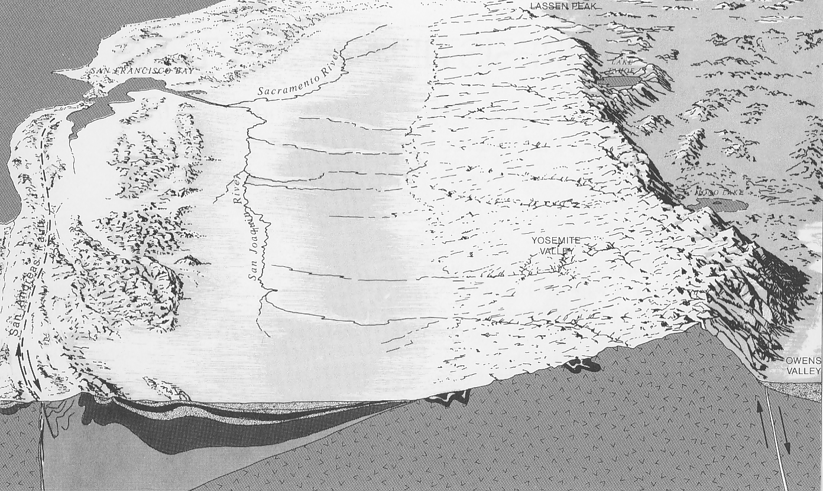
The Sierra Nevada is the geologic backbone of California, and separates the Great Central Valley from the Basin & Range. The range tilts westward, is 400 miles long and between 40-80 miles wide.
Johnson (1971)

Slide 20
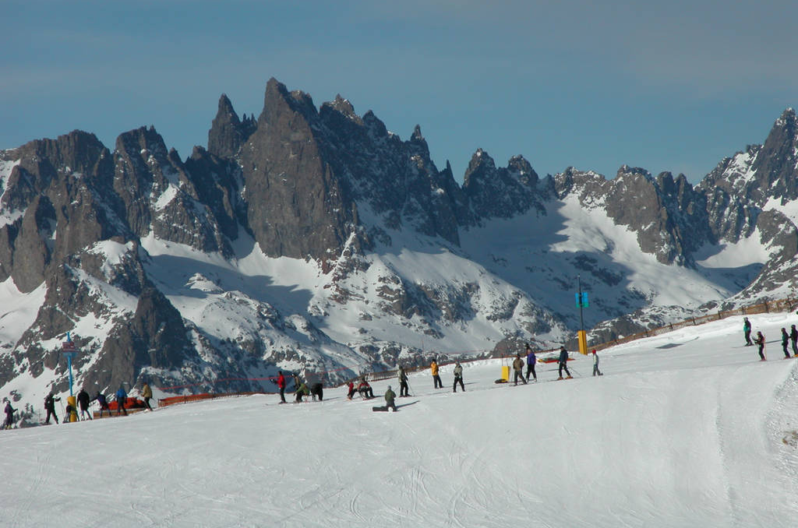
Although popular for winter recreation, the Sierra snowpack is a water reservoir for cities and fields throughout lowland California.

Slide 21
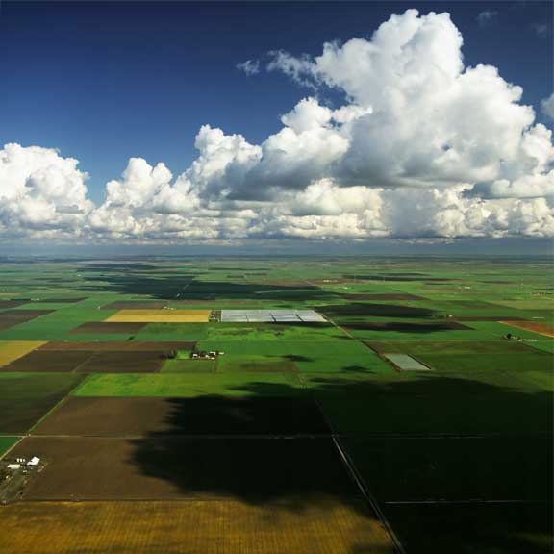
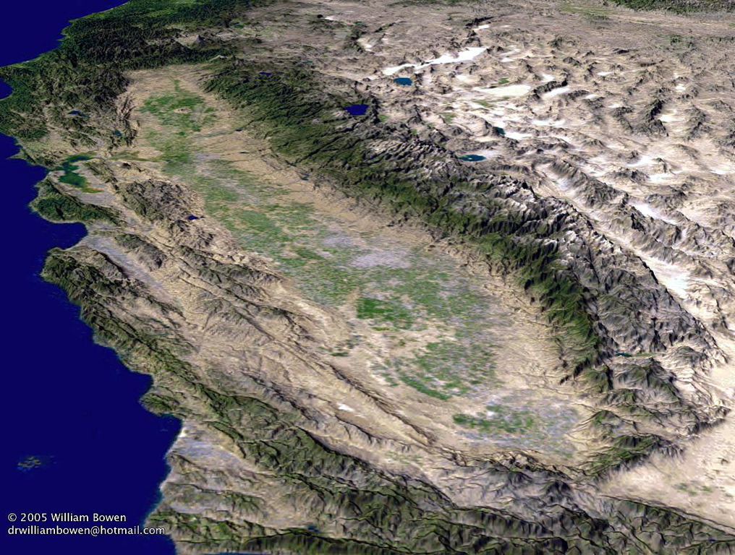
Great Central Valley
This 400-mile long valley—the most level part of California—is the most productive agricultural region in the world. A network of canals, aqueducts, and pumps sustains fields and livestock. San Francisco Bay is the only outlet to the sea.

Slide 22
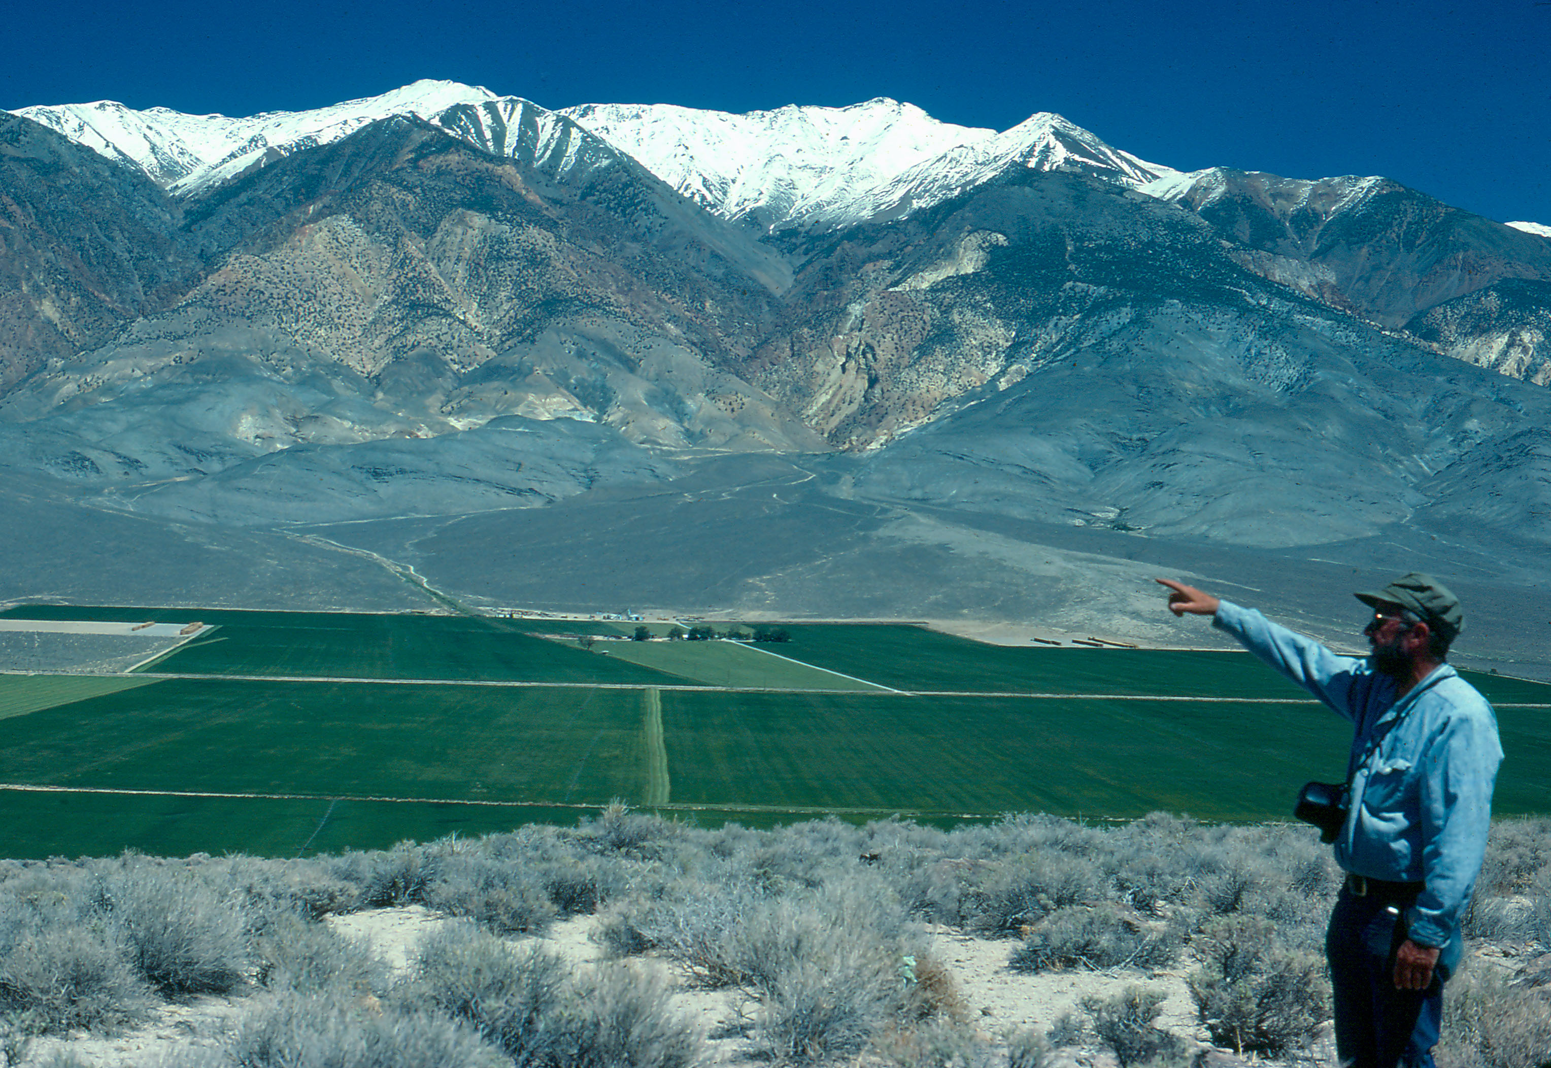
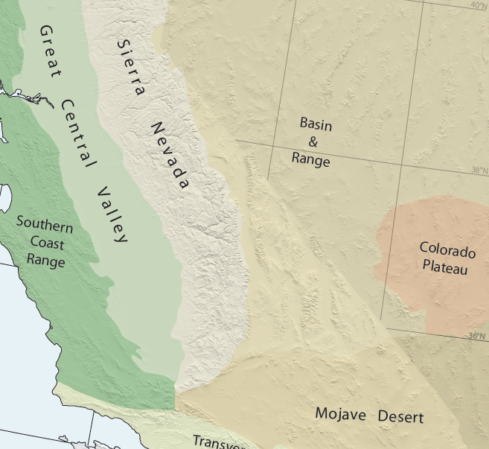
The Basin & Range stretches from eastern California to the Rocky Mountains. There is no outlet to the sea.

Slide 23
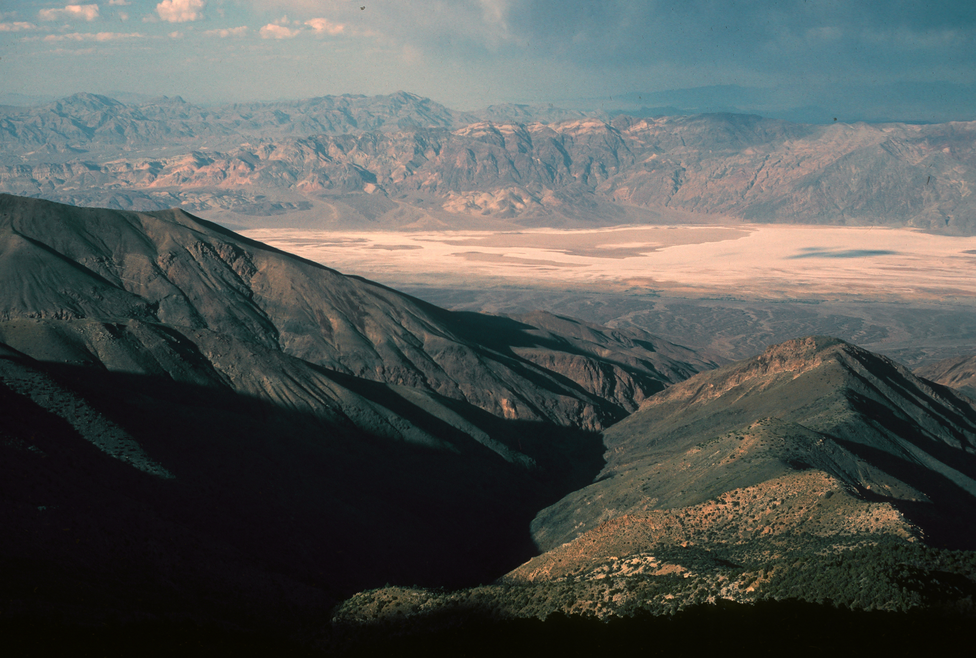
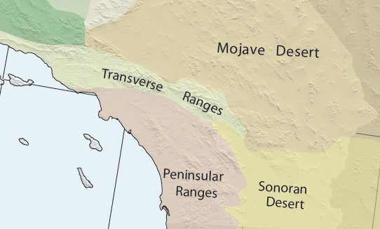
Death Valley is the lowest (-282 ft.) and hottest location in the Mojave Desert.

Slide 24
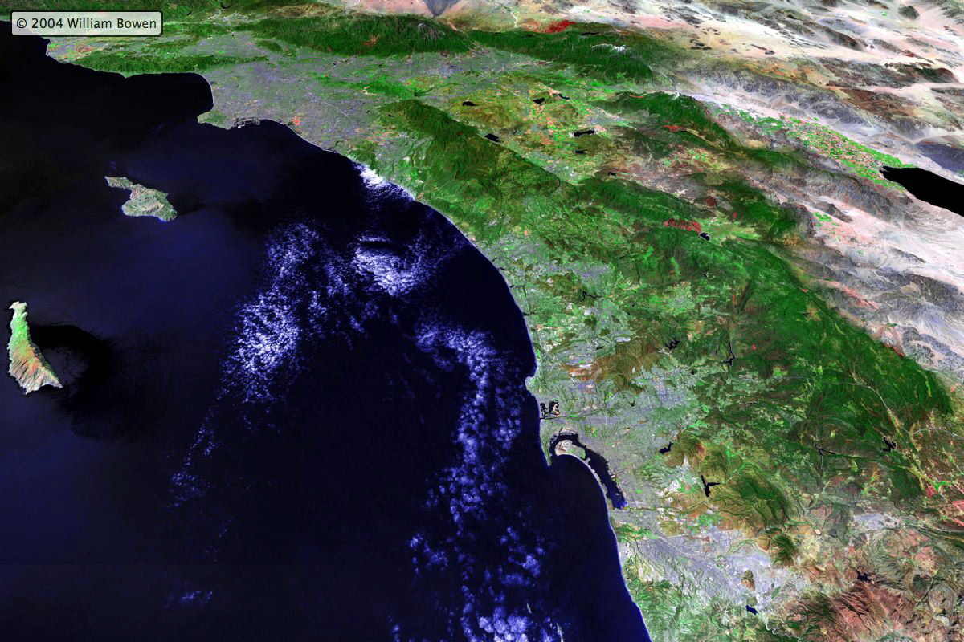
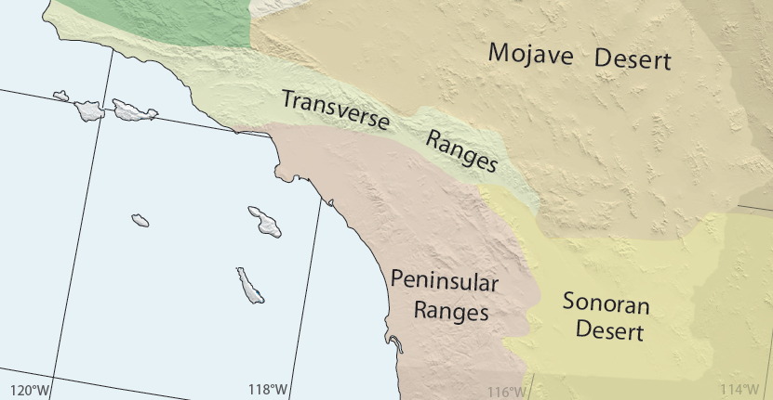
Terrain Map
The Transverse and Peninsular Ranges separate the coastal plains of Southern California and San Diego from the Mojave and Sonoran Deserts. The red line is the boundary with Mexico.

Slide 25
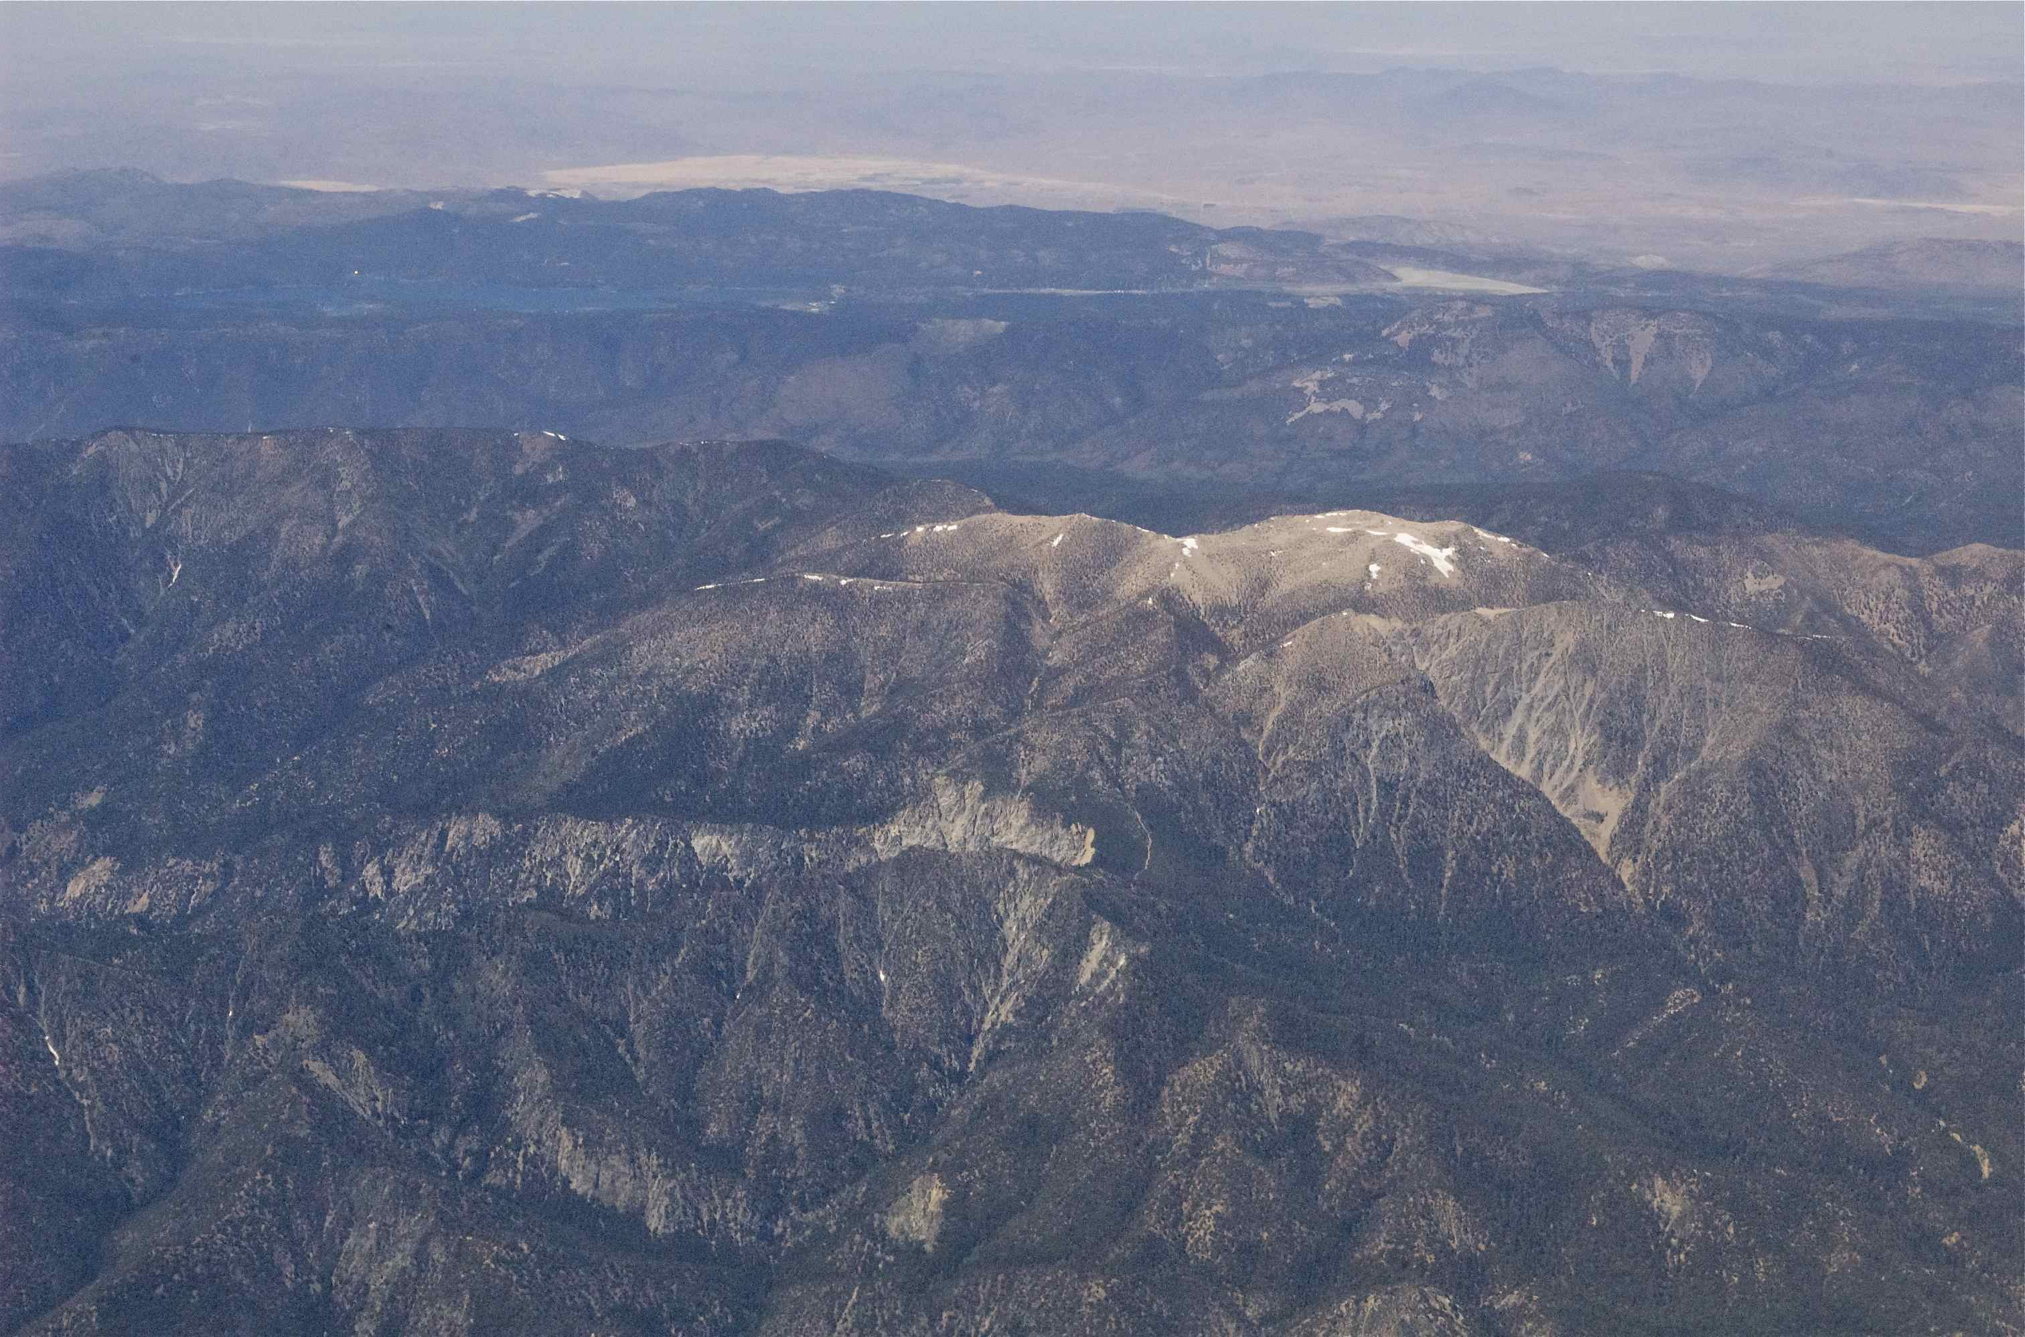
The Transverse Ranges stretch from the Santa Monica Mountains to the San Gabriel and San Bernardino Mountains, and bisect the Southern California coastal plain from the Mojave Desert.
Mojave Desert
Mt. San Gorgonio (11,501’)
Notes:
The Transverse Ranges include the Santa Monica Mountains, which extend offshore to form the Northern Channel Islands of Santa Cruz, Santa Rosa, and San Miguel off the coast of Santa Barbara County. Three hundred miles east, the Transverse Ranges terminate abruptly in the San Gabriel and San Bernardino mountains, dropping off into the Mojave and Colorado deserts.

Slide 26
Arid winds from the interior Mojave Desert rush through low gaps in the Transverse Ranges, then flow across Southern California’s densely populated coastal plains.

Slide 27
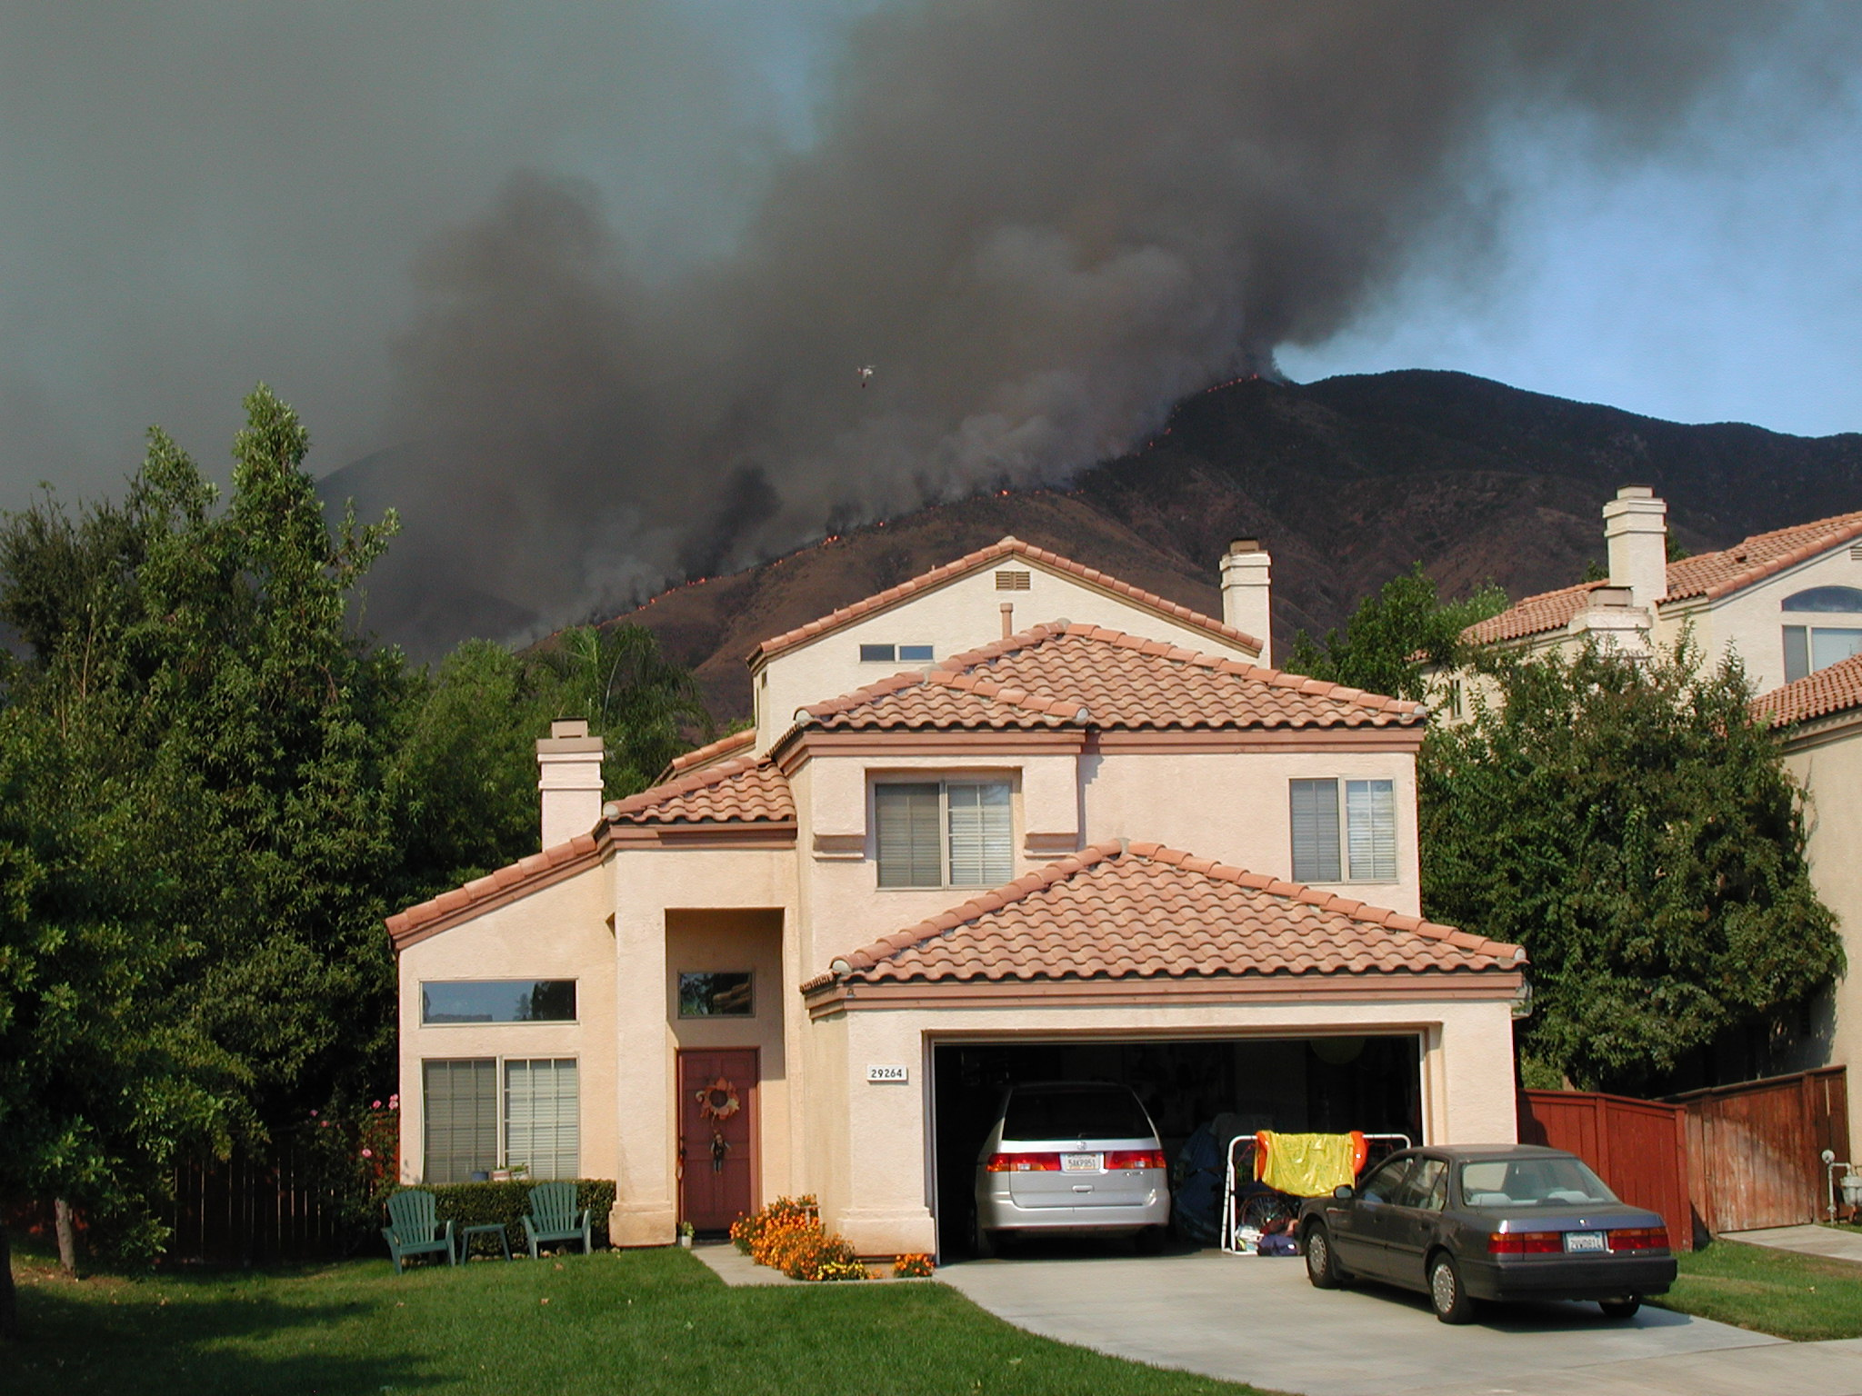
Periodic fires are a natural part of the chaparral life cycle.
J. Zorn

Slide 28
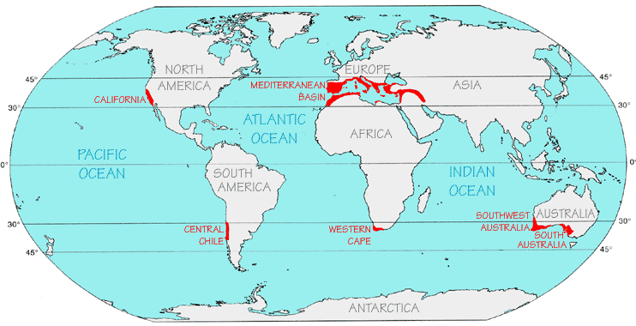
Unique California: Climate
Mediterranean climate covers only 2% of world
unreliably wet winters ~ reliably dry summers
mountains catch moisture for parched lowlands
Grabov Rat; F. DiCastri, Goodall, Specht (1981)

Slide 29
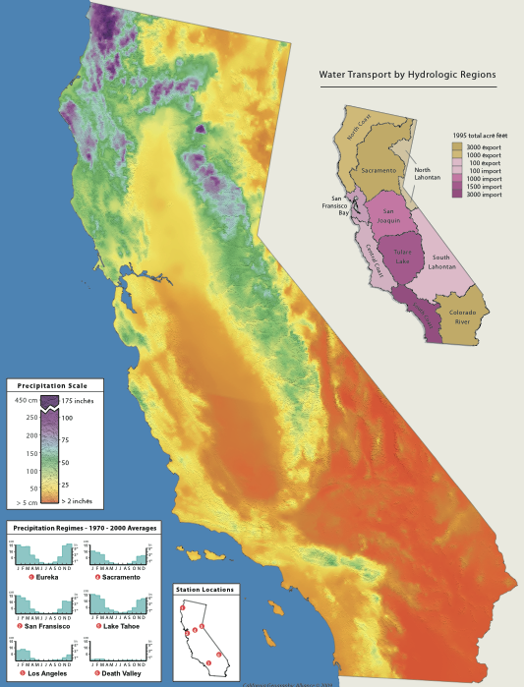
Annual Precipitation
Most precipitation falls in a giant horseshoe-shaped ring of mountains that surround the Sacramento Valley.
This includes the northern Coast Range, Klamath and Trinity Mountains, Mt. Shasta and Lassen Peak, and the northern Sierra.
Over 90% of the moisture falls during the winter months as rain or snow in the higher elevations.
PRISM © 2010

Slide 30
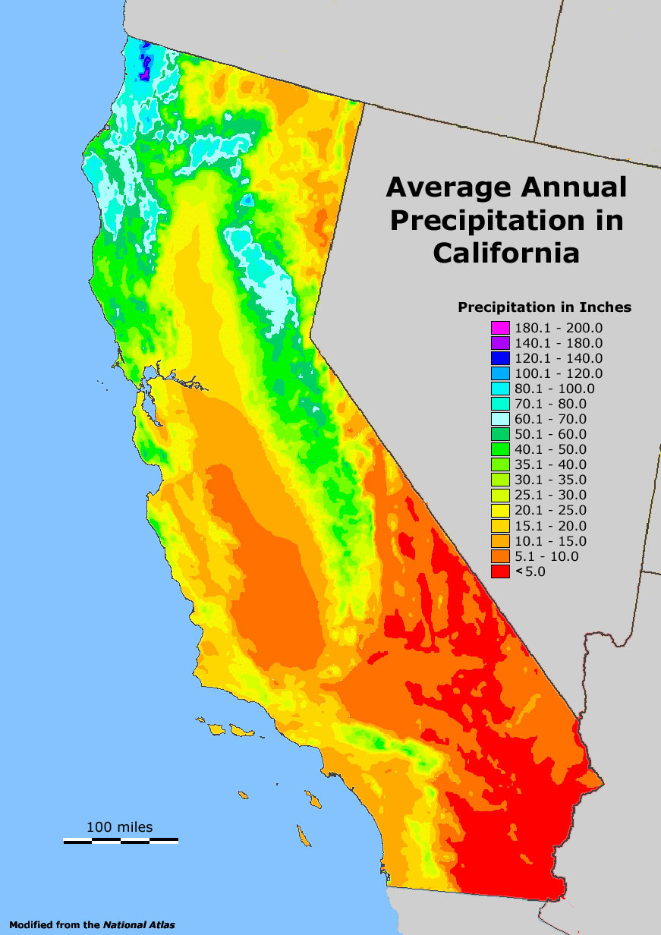
California precipitation decreases:
North to South
West to East
In rainshadows on the leeward sides of mountains
North to South
East to West
In Rainshadows
Notes:
A rainshadow is the leeward side of the mountain (opposite the direction of incoming storms). The windward side faces

Slide 31
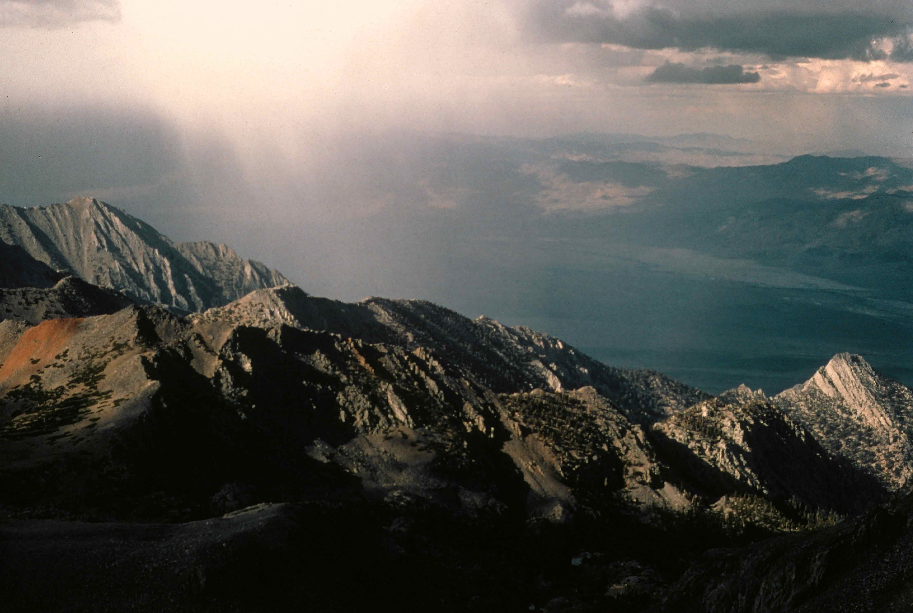
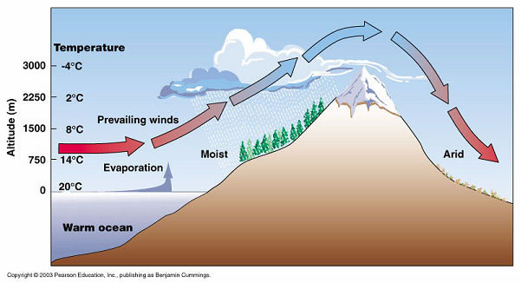
The windward west side of the Sierra Nevada blocks Pacific storms, leaving the Great Basin in an arid “rainshadow.”
Pearson Education/Cummings (2003)

Slide 32
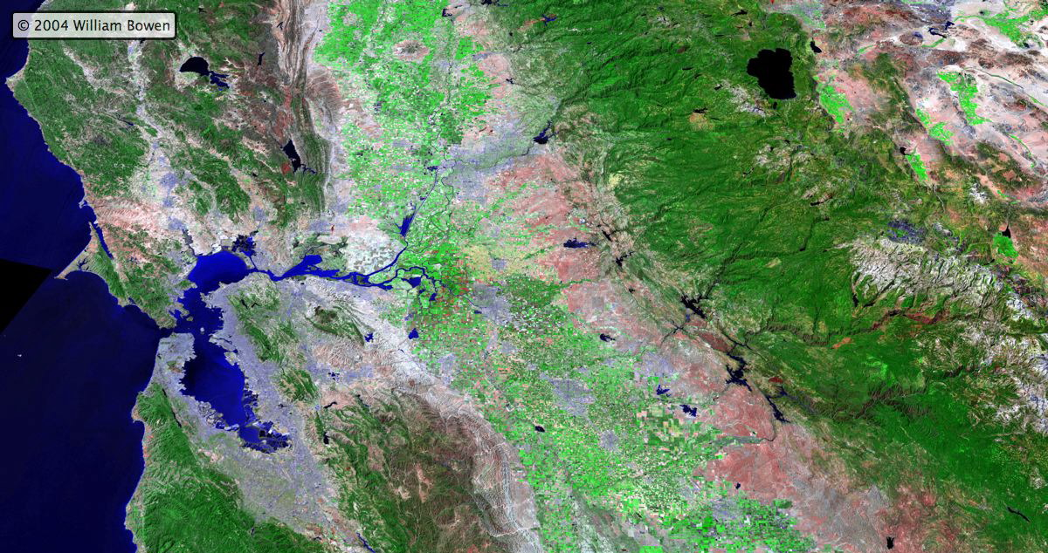
Precipitation Transect: Sierra Nevada Rainshadow
San Francisco: 21”
Sacramento: 17”
Auburn: 40”
Blue Canyon: 60”
Donner Summit: 70”
Truckee: 25”
Reno: 7”
Ely: 3”
Elevation Profile

Slide 33
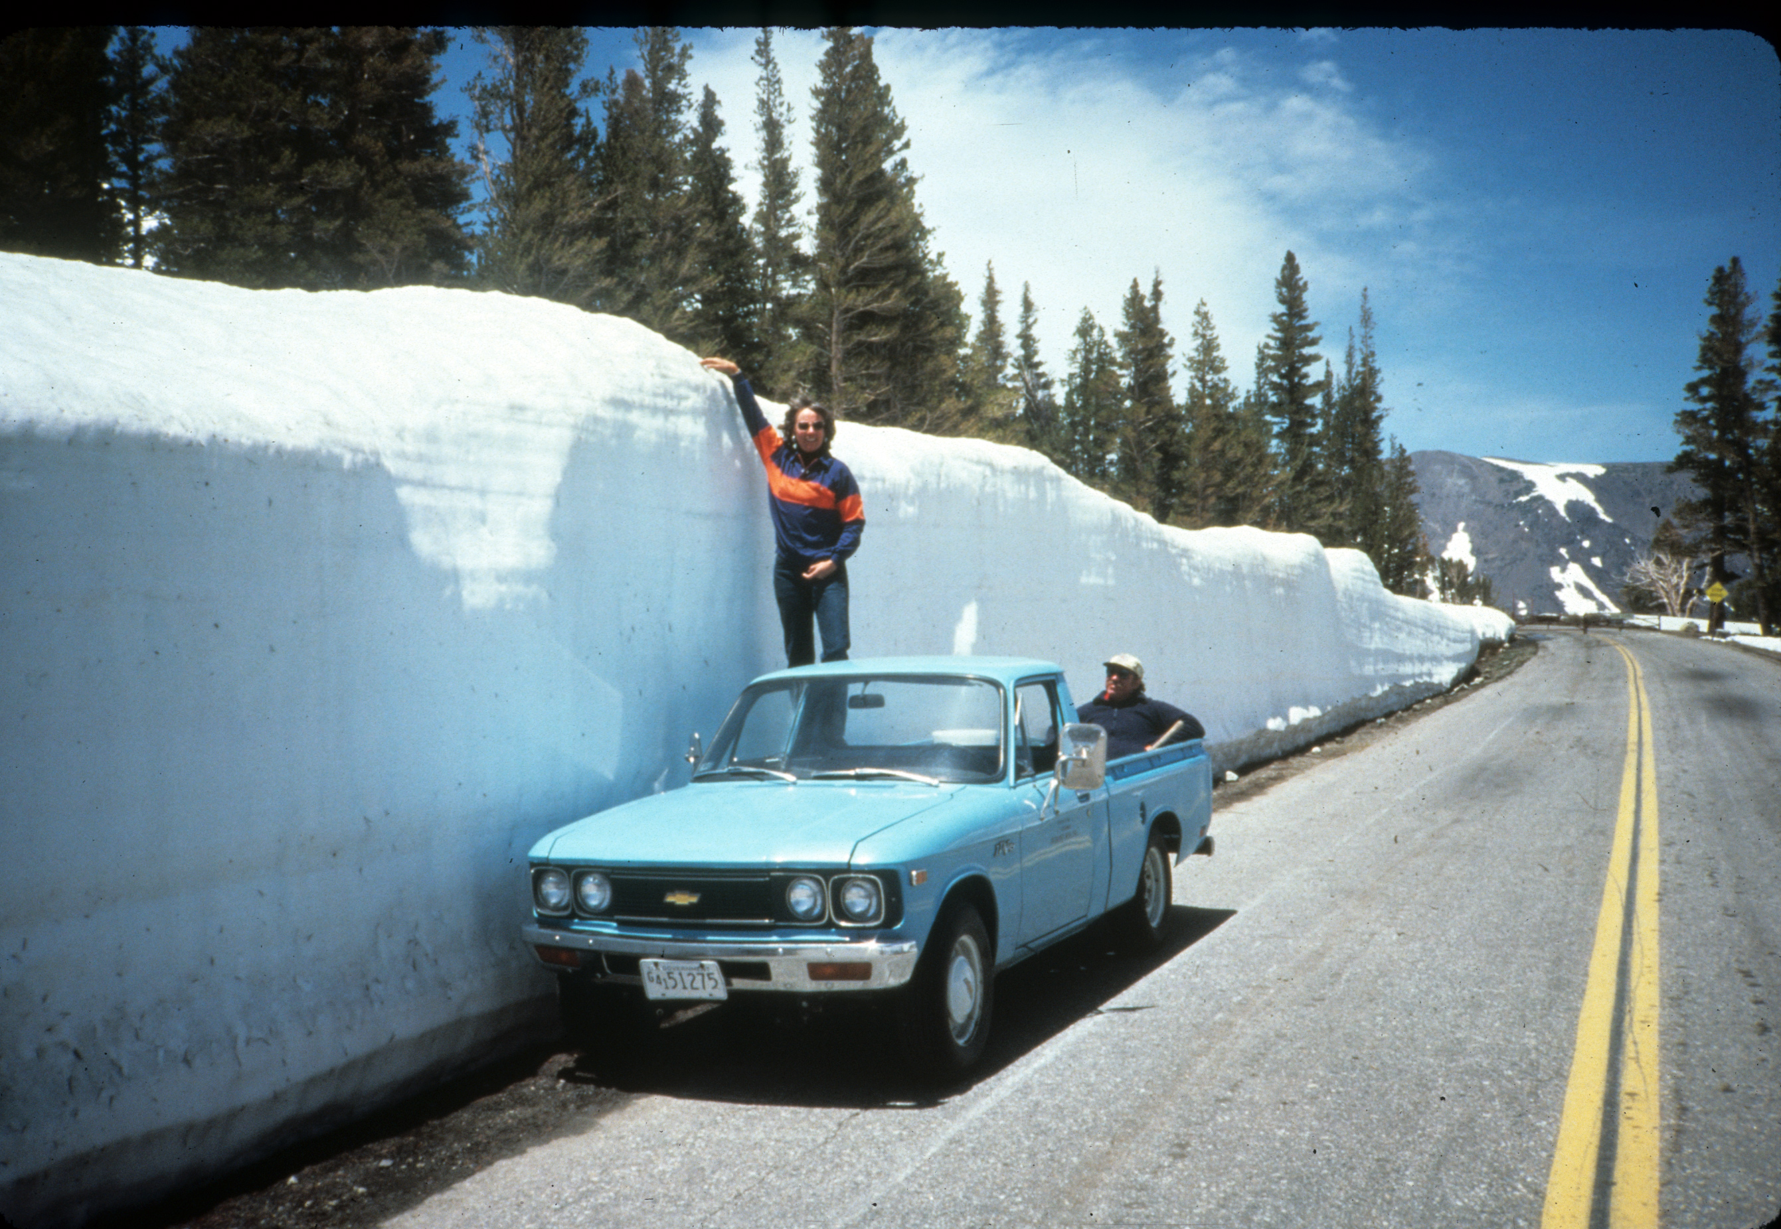
Mountains catch and retain moisture…
July snowpack at Tioga Pass, Yosemite

Slide 34
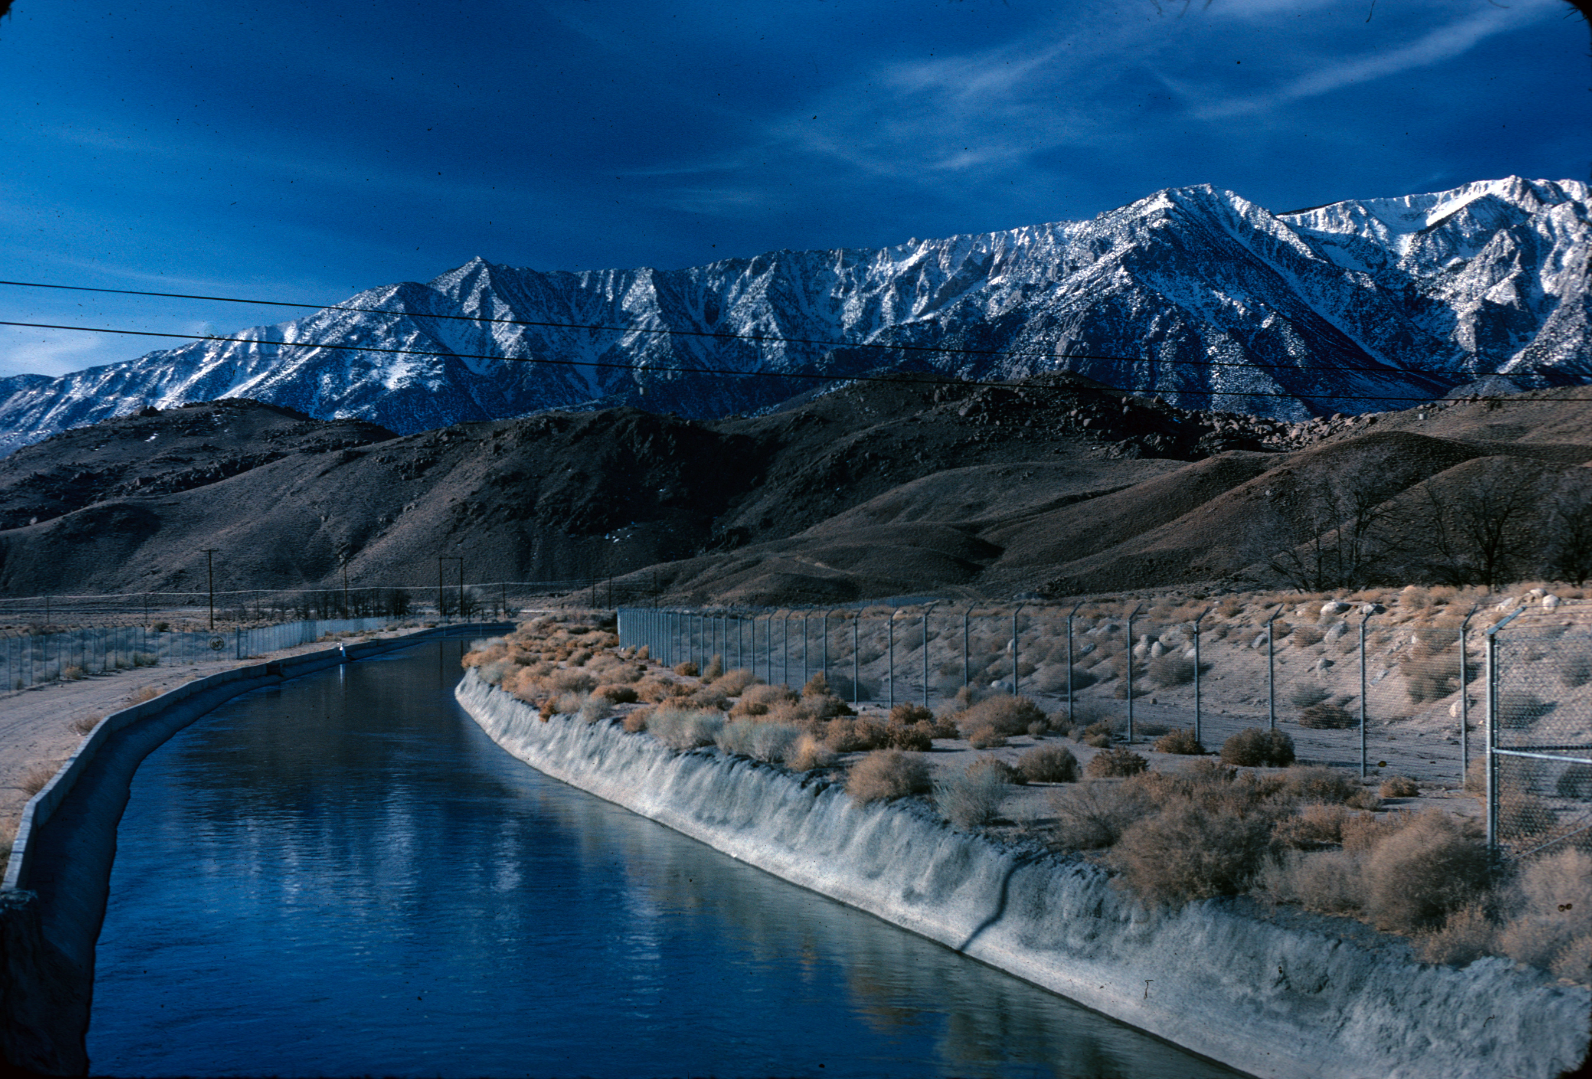
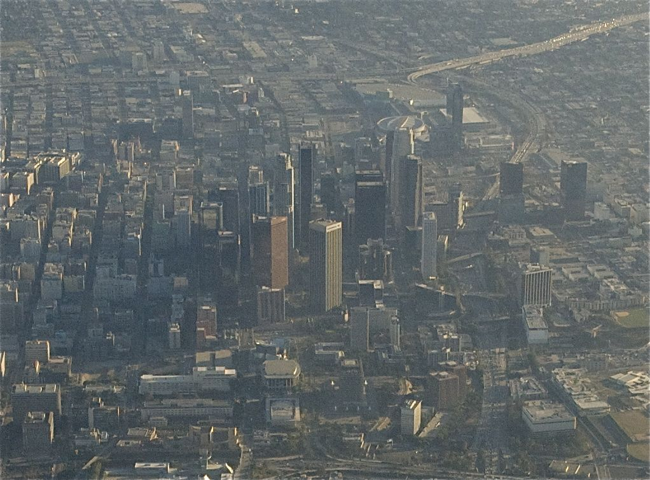
… for transport to cities and farms—80% of California water goes to crops and livestock.
The Los Angeles Aqueduct carries water south from the eastern Sierra Nevada.

Slide 35
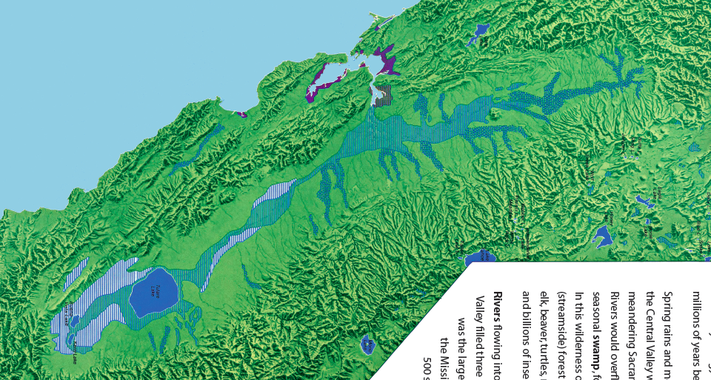
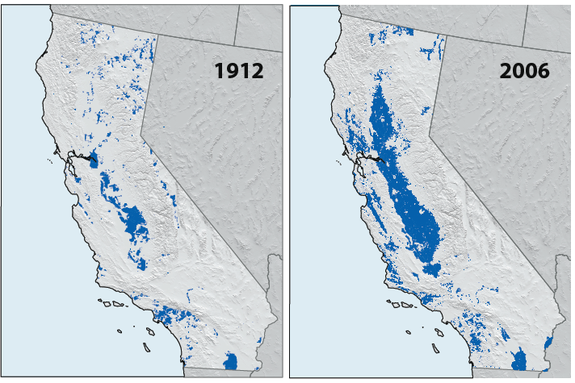
Irrigation Growth
Hydrology before human settlement.
Spring rains and melting snow once flooded the Central Valley (right). The meandering Sacramento and San Joaquin Rivers would overflow to form an enormous seasonal swamp 4 million acres in size. Today, less than 10 percent of these wetlands remain, but much
of that water now irrigates crops and livestock.
Bowen
(1979)
CA Dept Water Res
Notes:
80% of California water goes to crops and livestock

Slide 36
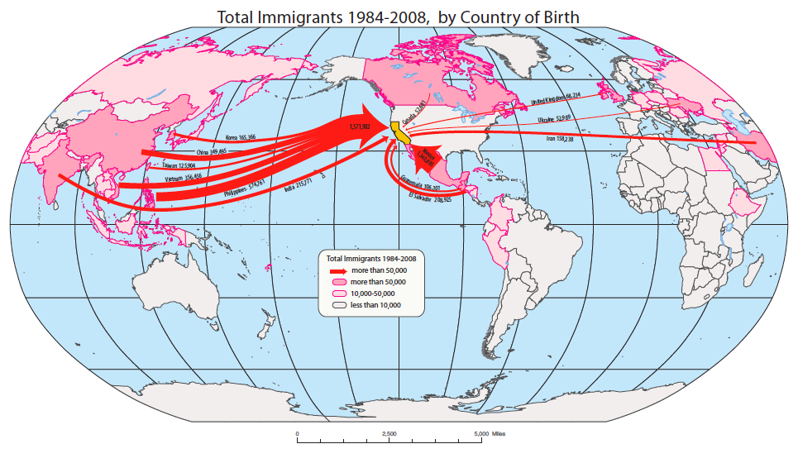
Unique California: Population
most diverse native populations in the Americas
26% of present Californians were born outside the USA
now the most diverse large-population in world history
Homeland Security; CA Public Policy Inst; INS Stat Yrbk; CA Dept Finance Legal Imm Summary

Slide 37
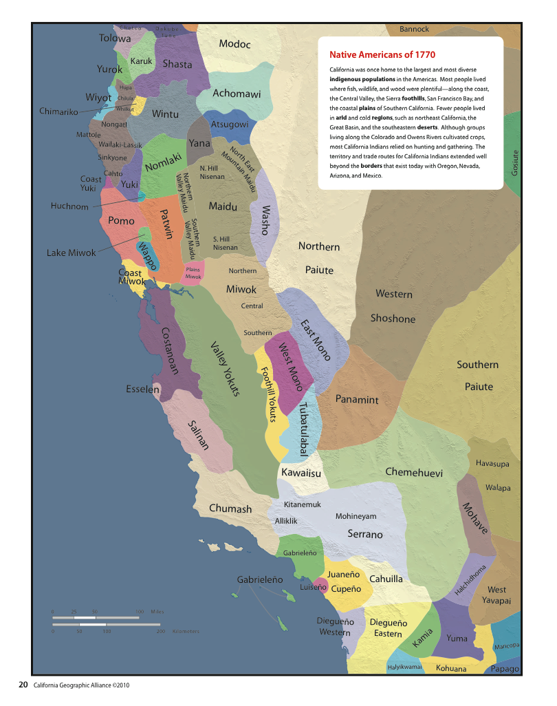
California’s varied landscapes were home to the greatest density and diversity of indigenous people in the New World.
Settlement History
UC Publ.AmArch.and Ethn, V 38; Atlas CA (1979); CA Patterns (1983); UC CA Indian Lib. Coll.

Slide 38
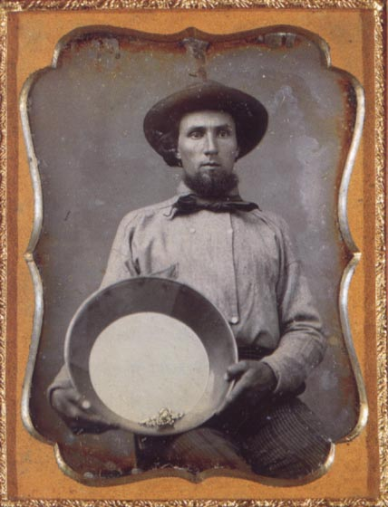
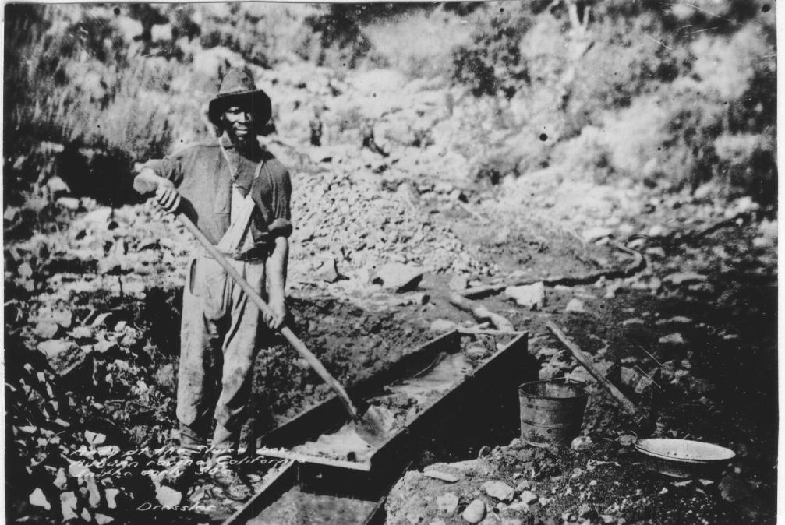
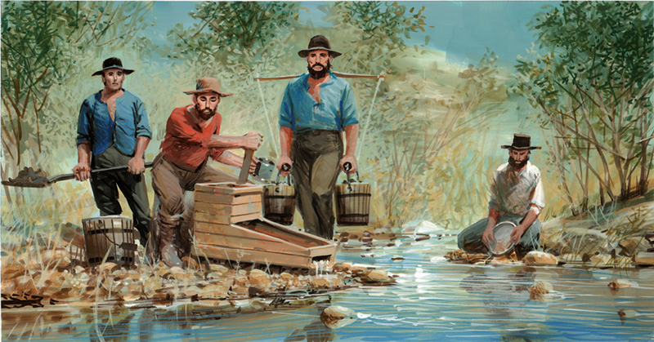
The Gold Rush was the epic and lasting immigration event—one that proved rare in world history
Enduring impacts
Native decline
Global immigration
CA statehood
County boundaries
Wildlife decimation
Sedimentation
Hg in SF Bay/Delta
Univ. California
US Postal Service
Notes:
Hg is the periodic table symbol for mercury. It was used to separate gold from overburden, and remains in bottom sediments of the SF Bay-Delta ecosystems.

Slide 39
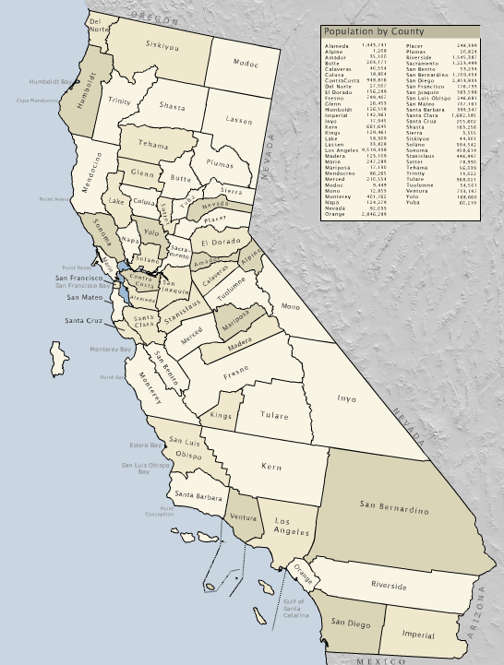
California’s 58 Counties
The initial Gold Rush and Bay Area counties are smaller because mountain terrain and water bodies made travel and communication difficult.
Population Division Estimate, US Census (2008)

Slide 40
Settlement History
after the Gold Rush, 4 of 5 lived between SF and the Sierra foothills
after WWII & the 1960’s baby boom, CA topped USA in population
since 1990, domestic out-migration has exceeded in-migration
Century Population
Change
1860 ~ 1960
Post
Baby Boom
Post Gold Rush
US Census (2000)
US Census (2000)

Slide 41
Latin America is currently the largest area of origin for new Californians.
Pearson Education (2005)

Slide 42
As foreign immigration grows, native Californians dwindle.
Annual Net Domestic Migrations: 2000 - 2004
Incoming domestic
immigration
Outgoing domestic
immigration

Slide 43
Southern California is among the most diverse places on Earth.

Slide 45
Century Change

Slide 46
In 1900 Bodie was one of the largest towns in eastern California. A century later 99 percent of its residents had moved on…

Slide 47
... while Los Angeles blossomed into the largest North American Pacific Rim city.

Slide 48
Unique California: Economy
8th largest economy in the world
106 billion in foreign exports per year
10 of 15 top markets are Pacific Rim countries
J. Cunha
International Trade Admin; US Dept Commerce; CA Technology, Trade &Commerce Agency

Slide 49
Top 10 World Economies

Slide 50
Silicon Valley is the nerve center of Digital Age innovation.
Stanford University

Slide 51
Manufacturing a Future?
currently shedding manufacturing jobs
jobs going to Latin America and Asia
high technology remains productive and promising
A Televisa crew in Mexico City records on a MacBook
International Trade Admin; US Dept Commerce; CA Technology, Trade & Commerce Agency

Slide 52
Agricultural Exports of California and the Top 15 Importing Countries
UC Agric Issues Center (2009)
California is the fifth largest provider of food in the world.

Slide 53
In 2006, California international agricultural exports totaled 9.8 billion dollars.
Nuts to Iran (from Chico), via the United Arab Emirates
UC Agric Issues Center (2009)

Slide 54
Sustained by irrigation from mountain snow and groundwater, the Great Central Valley is the most productive agricultural region in the world.
San Joaquin Valley
Sacramento Valley
Prof. Wm. Bowen

Slide 55
Sacramento Valley rice fields Provide habitat for waterfowl
R. Campbell

Slide 56
But our agricultural lands are succumbing to urbanization.
Central Valley urban centers:
Are replacing croplands
Will eventually rival So Cal
Increase regional temperatures
Provide more affordable housing
Use much less water than crops
Farmland Mapping & Monitoring Pgm; CDC; CDF; CDWR

Slide 57
The land of Queen Califa is unique due to…
Review…
Location
Size
Topography
Climate
Population
Economy

Slide 58
For more on California geography refer to: calgeography.org

Slide 59
California:
Much more than missions and a Gold Rush
~ ~ ~ ~
The California Atlas was produced by the California Geographic Alliance with generous support from:
Education Foundation
Author: Stephen F. Cunha, Ph.D.
Supervising Editors: Roni Jones and Emily Schell, Ed.D.
Cartography: Institute for Cartographic Design, Humboldt State University
Cartography Team Director: Mary Beth Cunha, M.A.
Administrative Manger: Mary Hackett

